Slide 1
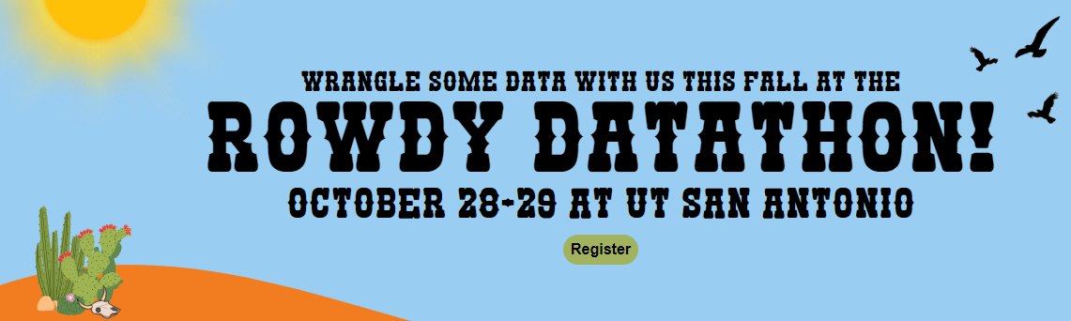

Introduction to R Coding
and Applications in Environmental Data Science
Today’s outline:
- Install R and R Studio
- Download scripts, data from GitHub
- Script 1: R basics
- Script 2: Ecology example
- Script 3: Urban heat island example
- Script 4: Bexar County land cover change
Matt Troia, PhD
Assistant Professor
Department of Integrative Biology
Fish Ecophysiology and Conservation Lab
matthew.troia@utsa.edu
www.troiaecology.org

Slide 2
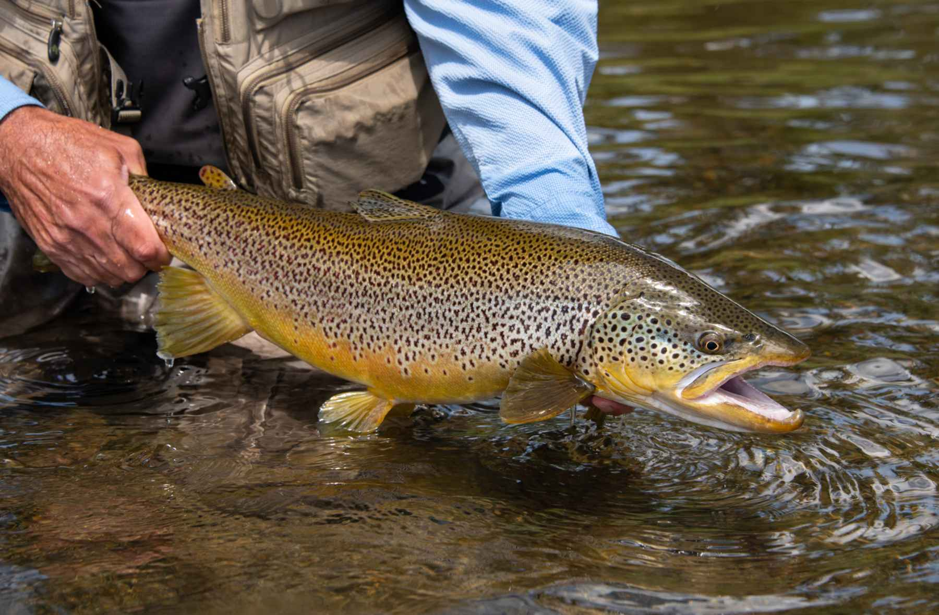
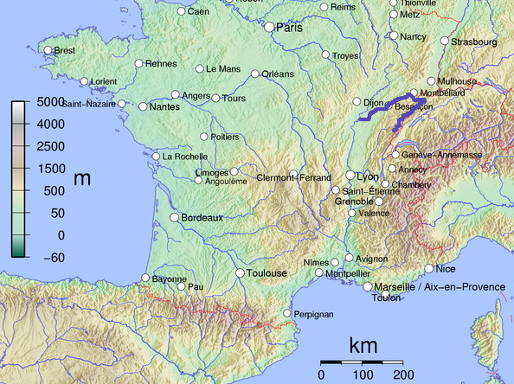
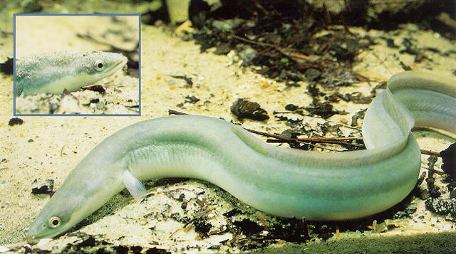
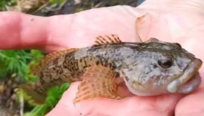
2) Doubs fish data
Brown trout
vikedia
Hatch Magazine
Eel
- 30 sites
- 27 species
- 9 in-stream habitat variables
- 4 geographic variables
USGS
Bullhead
Verneaux, J. (1973) Cours d'eau de Franche-Comté (Massif du Jura). Recherches écologiques sur le réseau hydrographique du Doubs. Essai de biotypologie. Thèse d'état, Besançon. 1–257.
Spotwild

Slide 3

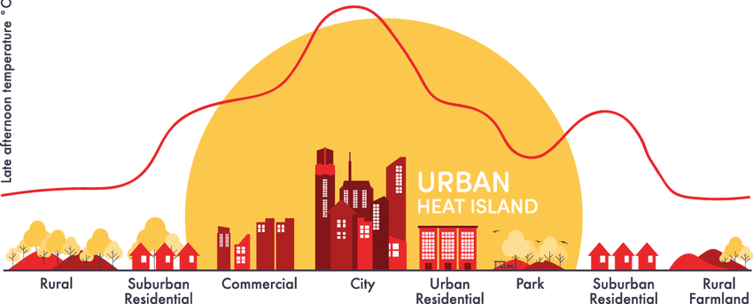

3) Urban heat islands
- Temperature data from WorldClim
- Mapping and geospatial analysis
with Terra R library

Slide 4
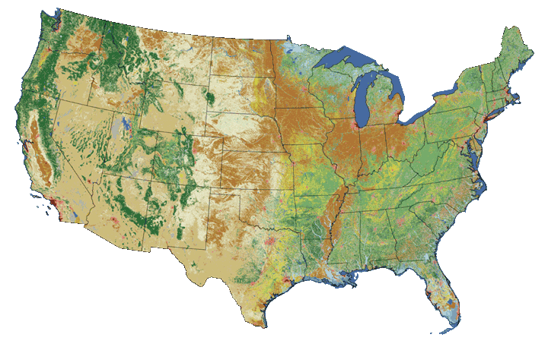
4) Land cover change
- National Land Cover Dataset (NLCD)
- 30-m raster data (gridded cells)
- Every 2-3 years from 2001-2021

